Slide 1
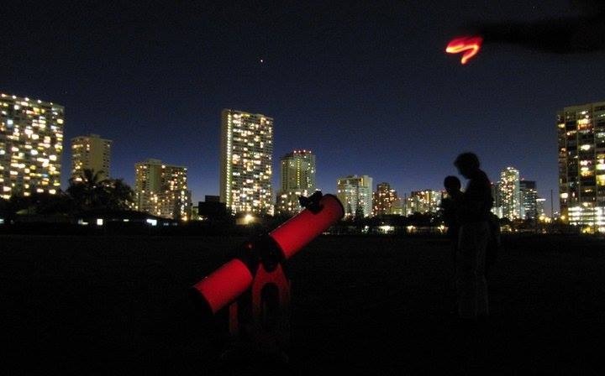
Sidewalk Astronomers
Sidewalk Astronomers
Have telescopes – will travel

Slide 2
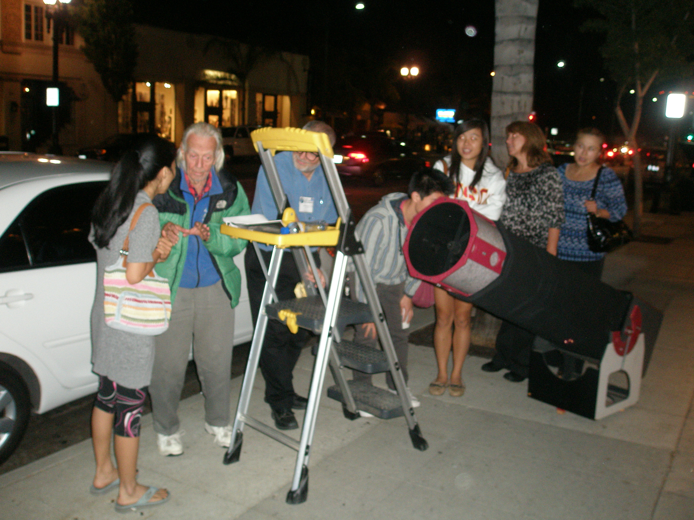
Who are the Sidewalk Astronomers?
Has shown cosmos to public for over 40 years
Has professional and amateur astronomers working together
Has groups that partner within their local communities
Has outreach done in creative ways
Has respect and stewardship of the night sky

Slide 3
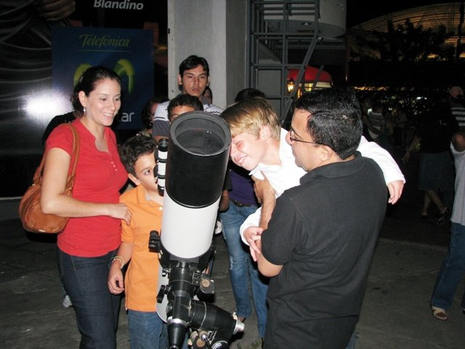
What is Sidewalk Astronomy?
Public Astronomy - conducted on sidewalks, in parks, at observatories, planetariums and libraries
Free Astronomy – sidewalk astronomy is a gift to the community
Accessible Astronomy – by going to where the people are more people are given opportunity
Educational – along with observing, information is always given so that people know what they are seeing.
Conduct outreach – which is an important part of sidewalk astronomy.
Telescope Making – many members are active amateur telescope makers

Slide 4
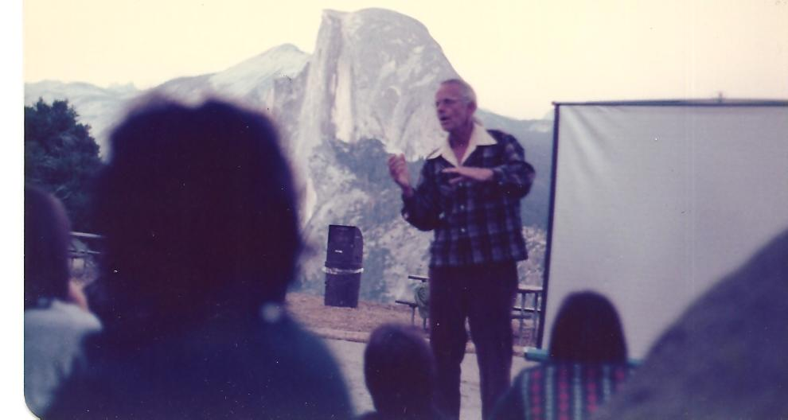
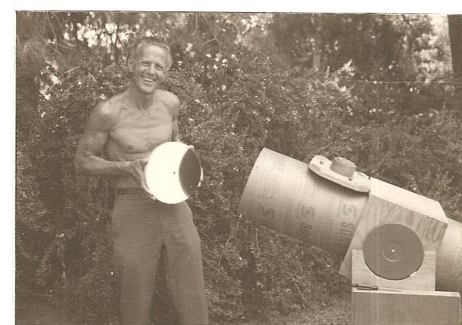
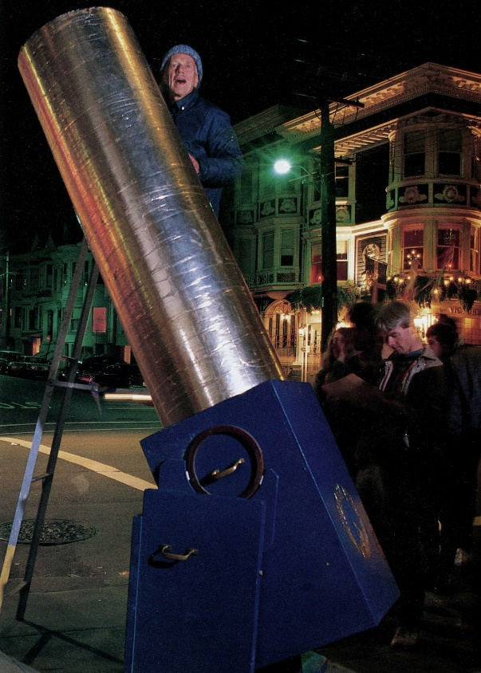
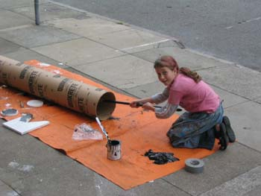
History of the Sidewalk Astronomers
Started undercover at a monastery by John Dobson in late 60’s.
The first Dobsonian Telescope started it all – out of repurposed materials
Moved to the corners of Broderick & Jackson Streets, San Francisco in 1969 – using large telescopes to show the public where they live.
Introduced into the National Parks in early 1970s – where people and dark skies collide.

Slide 5
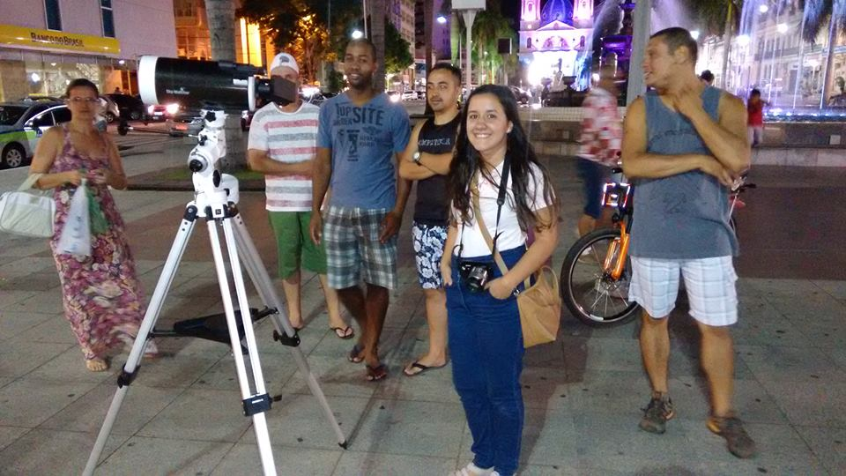
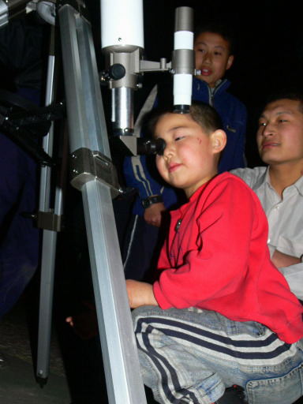
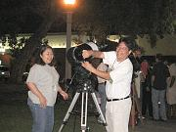
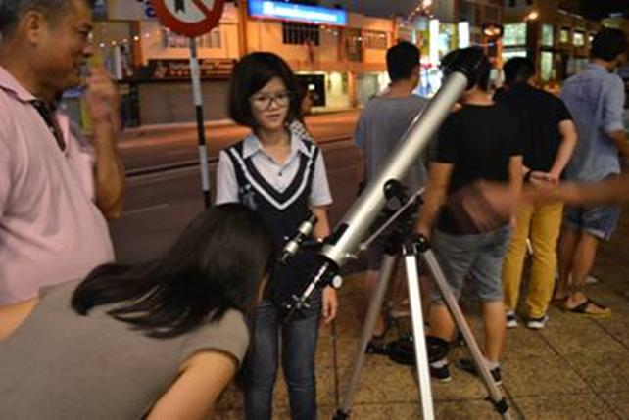
Sidewalk Astronomers Today
Celebrates John every September – John Dobson Month and John Dobson Day September 14th
International members is in ??? countries
Offers over 15 programs
Celebrates sidewalk astronomy internationally - ISAN – International Sidewalk Astronomy Night
Has solar sidewalk astronomy facet – International Sun Day
Partners with other organizations like IDA and Globe@Night
Provides free resources

Slide 6
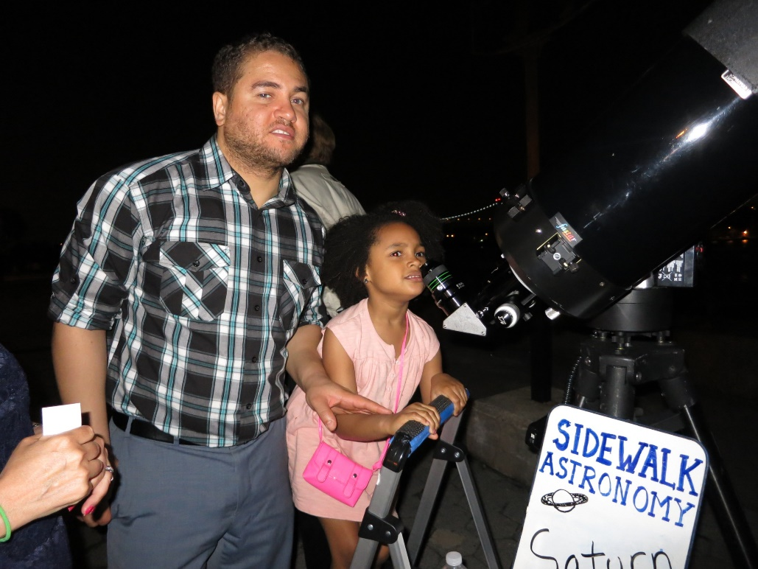
Becoming a Sidewalk Astronomer
Join by signing up on website at: sidewalkastronomers.us
Will automatically receive the newsletter “The Sidewalk Astronomer”
Review Resources on-site articles on
- observing tips, site selection,
- hands on activities, handouts, etc
Equipment needs – buying or building telescope, - how to articles and directions and telescope plans
Personal help available

Slide 7
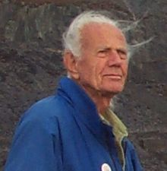
“Go to where the people are”
John Dobson
Sep 14, 1915 – Jan 14, 2014

